Slide 1
CGRA Architecture and Design Methodology
Priyanka Raina
AHA Retreat
May 31, 2019

Slide 2
Coarse Grained Reconfigurable Array (CGRA)
CGRA Programming
Toolchain
PE
MEM
PE
MEM
Application in Halide
Halide Compiler
PE
MEM
PE
MEM
CoreIR Graph
Mapper
Place and Route
PE
MEM
PE
MEM
Configuration Bitstream
Configured CGRA
PE
MEM
PE
MEM

Slide 3
Challenges with Jade CGRA
1. PE supports only simple integer operations
Porting applications that use floating point requires application expertise and manual effort

Slide 4

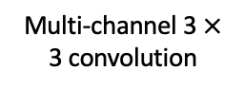
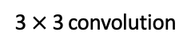
Challenges with Jade CGRA
Memory supports only line buffered pipelines
Most new applications even for imaging and vision use neural networks
Need a memory hierarchy with double buffers for energy-efficiency
Input
Multi-channel 3 $×$ 3 convolution
3 $×$3 convolution
$$⊗$$
$$⊗$$
K of these
Line Buffer
Double Buffer

Slide 5
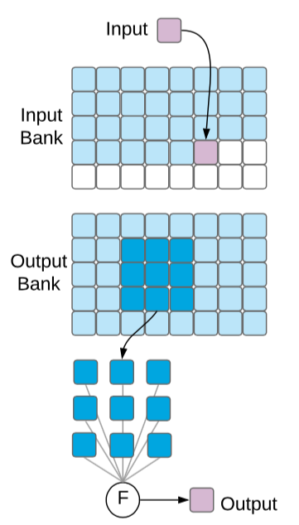
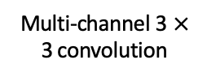

Challenges with Jade CGRA
Memory supports only line buffered pipelines
Most new applications even for imaging and vision use neural networks
Need a memory hierarchy with double buffers for energy-efficiency
Multi-channel 3 $×$ 3 convolution
2. Use a double buffer to overlap compute on current tile and fetching of next tile
3. Use a hierarchy of double buffers to maximize energy-efficiency
$$⊗$$
1. Bring in tiles of inputs and weights into local memory reuse them as much as you can
K of these
Image from: Jeff Setter

Slide 6
Challenges with Jade CGRA
Configuration over JTAG is slow
Large applications with multiple kernels don’t fit on the CGRA – need fast reconfiguration

Slide 7
Key (application driven!) architectural changes in Garnet CGRA
Floating point support, and executing complex operations like divide using multiple PEs
Addition of a global buffer to create a memory hierarchy for efficiently executing neural networks, and double buffer support in all memories
Fast reconfiguration support using global buffer and control processor
Addition of configurable power domains

Slide 8
Tomorrow’s talks
How did we update our design methodology to
Incorporate architectural changes easily
While maintaining an end-to-end application flow

Slide 9
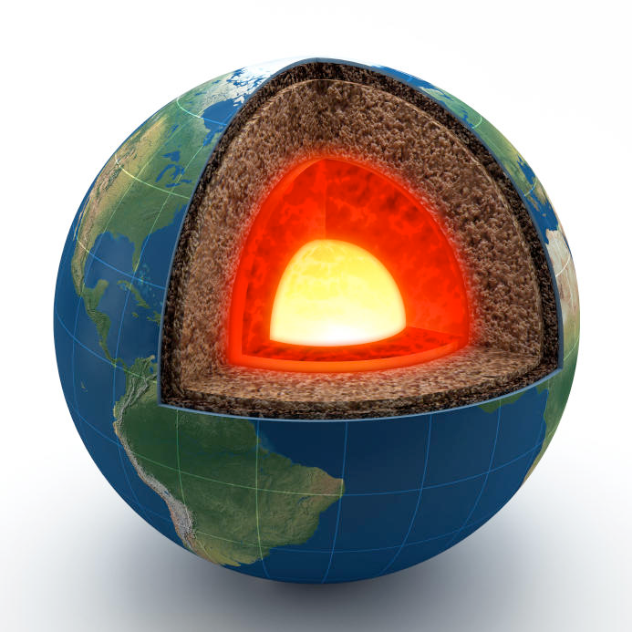
Magma and CoreIR Leonard Truong
Magma is our hardware description language embedded in Python
A magma circuit is basically a bunch of functional units wired together == Verilog module
Makes it possible to create higher-level domain-specific languages (DSLs)
For processors (peak), finite state machines (silica), verification (fault) etc.
Python meta-programs magma
Python
Much more powerful than SystemVerilog’s parameter and generate and Genesis’s text-based templating!
Magma
Image from: Lenny Truong

Slide 10
Magma Circuit
import magma as m
import mantle
from full_adder import FullAdder_
def DefineAdd(n):
class Adder_(m.Circuit):
name = f”Add{n}”
IO = [
“I0”, m.In(m.UInt(n)),
“I1”, m.In(m.UInt(n)),
“CIN”, m.In(m.Bit),
“O”, m.Out(m.UInt(n)),
“COUT”, m.Out(m.Bit),
]
@classmethod
def definition(io):
O = []
COUT = io.CIN
for i in range(n):
fulladder = FullAdder_()
OI, COUT = fulladder(io.I0[i], io.I1[i], COUT)
O.append(OI)
io.O <= m.uint(OI)
io.COUT <= COUT
return Adder_
Python Generator

Slide 11
Magma and CoreIR
Magma compiles into CoreIR – which is our LLVM-style hardware intermediate representation and compiler infrastructure
…
Verilog
Magma
Chisel
Halide
CoreIR
“LLVM for HW”
FPGA
CGRA
ASIC

Slide 12
CoreIR Primitives
Bitwise | buf, not, and, or, xor, andr, orr, xorr, shl, lshr, ashr
Arithmetic | neg, add, sub, mul, udiv, urem, sdiv, srem, smod
Comp | eq, neq, slt, sgt, sle, sge, ult, ugt, ule, uge
Stateful | reg, regrst, mem
Other | mux, slice, concat, zext, sext
Magma circuit == Verilog module == CoreIR graph of these primitives

Slide 13
CoreIR Passes
Constant folding
Dead circuit elimination
Elaboration of generators
Verification (for example map to SMT)
Technology mapping
Linking
Notes:
Debugging support (create name table)

Slide 14
Higher Level DSLs
Magma
CoreIR
Image source: https://physicsforme.com/2011/07/19/best-ever-measurement-of-earths-radioactivity/

Slide 15
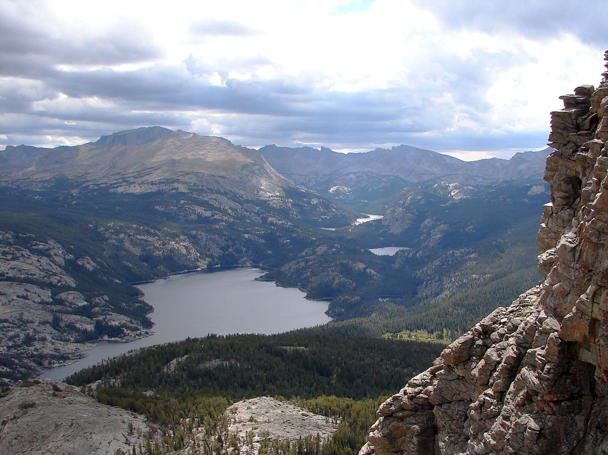
Peak
PE DSL
Lake
Memory DSL
Canal
Interconnect DSL
Image source: Jesse Varner - Raft Lake and the Little Wind River Valley beyond, https://www.flickr.com/photos/molas/1364382020/in/photostream/

Slide 16

Lassen and Peak Ross Daly
Diablo
Lassen
Whitney
Tapeout
Apr 2018
Jun 2019
…
Image source: https://pngio.com/images/png-77798.html

Slide 17
Diablo
Two 16 bit operands
Three 1 bit operands
data0
data1
bit0
bit1
bit2
Add
Mult
And
8 entry
1 bit lut register
…
ALU
Flag Logic
en_acc
res
res_p

Slide 18
Lassen
We wanted several new architectural features in Lassen
Native floating point add and multiply
Floating point micro-ops to easily implement complex operations (like divide, exp etc.) using multiple PEs and memory
Multi-precision integer ops
Without breaking the application flow!

Slide 19
Peak: PE DSL
Python-embedded DSL for describing the ISA and functional model of a PE
Has precise formal semantics
Automatically derive
RTL (using Magma/CoreIR)
Rewrite rules (from CoreIR primitive to PE instruction) for the mapper (using SMT)
Generate SMT formula for CoreIR primitive and PE (given an instruction). Use SMT solver to prove the two formulas are the same.
Collateral for bitstream generation

Slide 20
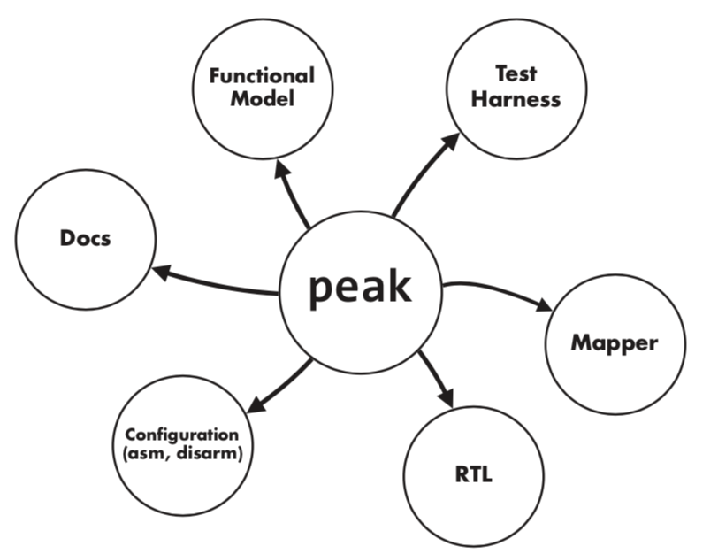
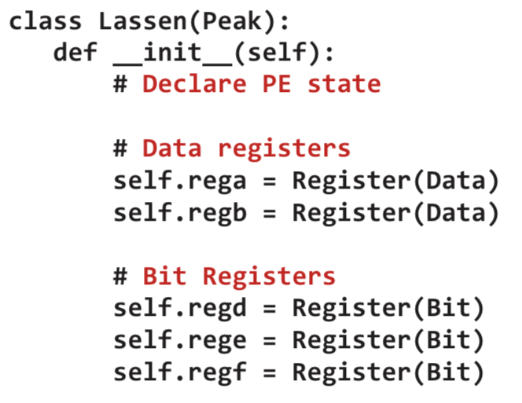
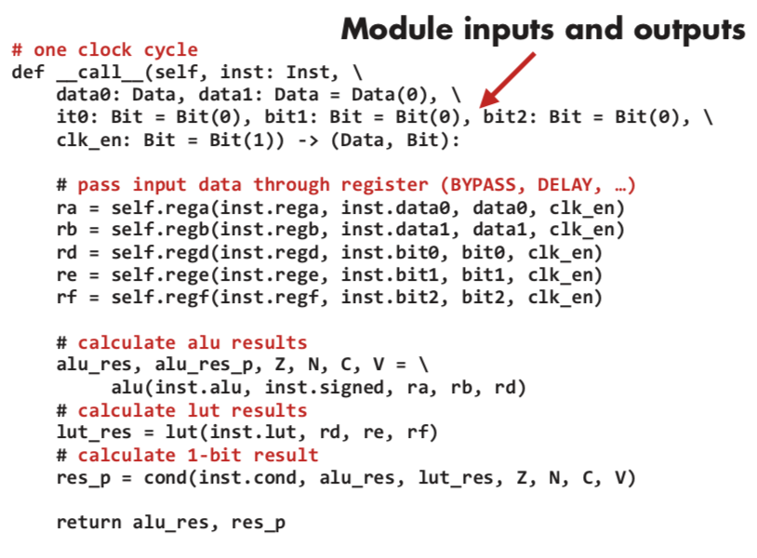
Peak

Slide 21
Memory and Lake Taeyoung Kong, Qiaoyi Liu
Two single port memory banks
Two single port memory banks
Two single port memory banks
Modes
Modes
Modes
FIFO Ctrl
SRAM 0
SRAM 0
SRAM 0
FIFO Ctrl
Unified Buffer with Address Generators
General Line Buffer Ctrl
Line Buffer Ctrl
SRAM 1
SRAM 1
SRAM 1
SRAM
Double Buffer Ctrl
SRAM
SRAM

Slide 22
Global Buffer
Highly banked global buffer provides configurable capacity and bandwidth for data and bitstream
0
1
2
3
4
28
29
30
31
…
64b
Distributed Address Generators
Programmable Interconnect for Data and Configuration
Fast parallel reconfiguration
0 | 1 | 2 | 3 | 4
 | 29 | 30 | 31
…

Slide 23
Global Buffer
Highly banked global buffer provides configurable capacity and bandwidth for data and bitstream
Config
Weights
Inputs
Psums
0
1
2
3
4
28
29
30
31
…
64b
Distributed Address Generators
Programmable Interconnect for Data and Configuration
Fast parallel reconfiguration
0 | 1 | 2 | 3 | 4
 | 29 | 30 | 31
…

Slide 24
Interconnect and Canal Keyi Zhang
Connection box (CB)
10 vertical and horizontal 16 bit tracks
5 driven up/left, 5 driven down/right
10-to-1 mux
PE
A
CB
B
CB
Similar 1 bit CBs for 1 bit inputs from 10 horizontal and vertical 1 bit tracks
SB

Slide 25
Switch Box
4
3
2
1
0
4
3
2
1
0
PE
SB
Pipeline register
4
3
2
1
0
4
3
2
1
0
4
3
2
1
0
4
3
2
1
0
4
3
2
1
0
4
3
2
1
0

Slide 26
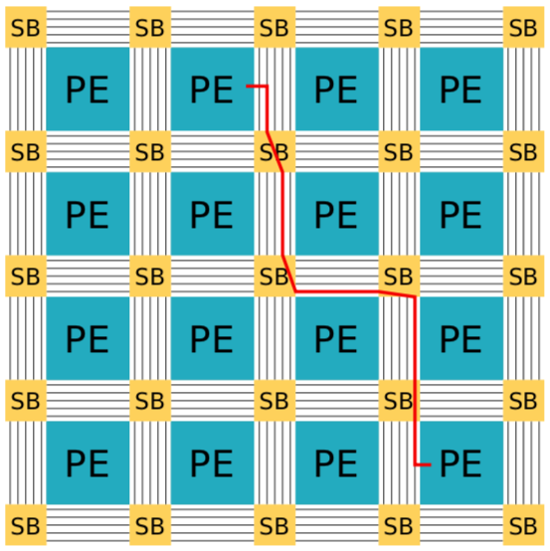
Interconnect and Canal
Place and route tool routes the output from one tile to the input of another tile by configuring these muxes
Image from: Keyi Zhang

Slide 27
CB design choices
In Garnet we changed the bias
CB Bias - which track direction and track number the CB is connected to
2 20-to-1 muxes
PE
B (identical mux as A)
CB
CB
A
SB

Slide 28
SB design choices
4
3
2
1
0
4
3
2
1
0
PE
4
3
2
1
0
4
3
2
1
0
4
3
2
1
0
4
3
2
1
0
Number of tracks
The length of each track segment
Internal SB topology
1
4
3
2
1
0
4
3
2
1
0

Slide 29
Canal
Canal lets you
Easily experiment with these interconnect design choices
Snap in arbitrary cores – inspects the interfaces to determine how many and what type of CBs and SBs the core needs
Generates the routing graph which feeds into the place and route tool
Generates configuration bitstream

Slide 30
Garnet and Gemstone Raj Setaluri, Alex Carsello
What is Gemstone?
Library of reusable CGRA components written in Magma/higher level DSLs
PE, Memory, Interconnect etc.
Methods that enable you to write passes on the RTL and a library of reusable passes
What is Garnet?
Our second generation CGRA built using gemstone components and passes
Image source: https://www.nwgems.com/products/natural-fine-intense-deep-red-garnet-oval-tanzania-top-grade

Slide 31
Gemstone Pass Example
Global Controller
Global Controller
Tile
Tile
Tile
Tile
Tile
Tile
Pass
Tile
Tile
Tile
…
Tile
Tile
Tile
…
Tile
Tile
Tile
Tile
Tile
Tile
…
…
River Routing of Global Signals

Slide 32
Gemstone Passes
Hardware design process should capture more than just the RTL
Logical Design (RTL), Physical Design, Testing/Verification, Software/API
Gemstone enables staged hardware generation
Each pass encapsulates different design knowledge
Passes can transform RTL to make it amenable to other portions of the design flow
Passes can generate collateral for other portions of the design flow (like physical design, verification)

Slide 33
Gemstone Passes
Verilog to physical design
Logical Description
Pass
Logical Description’
Pass
Logical Description’’
Pass
Logical Description’’’
Place and Route Flow
Initial RTL from logical designer
RTL with configuration registers distributed
RTL with global signals river routed
RTL with power domains
Testing Collateral
Floorplan

Slide 34
SoC Rick Bahr, Gedeon Nyengele, Teguh Hofstee
Control Processor
(ARM Cortex M3)
Application Processor
DRAM
DRAM Controller
Wake-up Interrupt Controller (WIC)
Nested Vector Interrupt Controller (NVIC)
Debug JTAG
Memory Protection Unit (MPU)
TLX
FPGA
I-Bus
D-Bus
TLX
AHB
AHB
CoreLink
AXI
AXI
AXI
AXI
AXI
AXI
SRAM
SRAM
DMA Engine
DMA Engine
Global Buffer
CGRA
SoC

Slide 35
Visual Applications and Halide-to-Hardware Jeff Setter, Xuan Yang
CGRA Programming Toolchain
Application in Halide
Halide Compiler
CoreIR Graph
Mapper
Place and Route
Configuration Bitstream
Configured CGRA

Slide 36
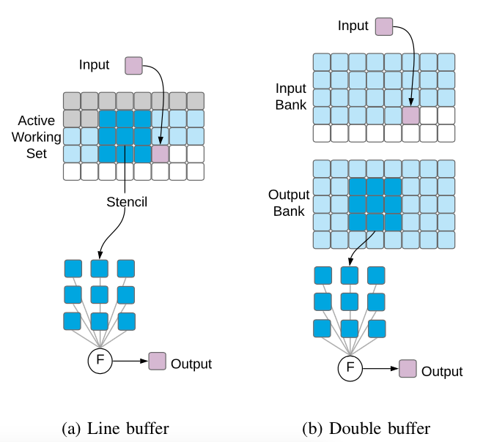
Visual Applications and Halide-to-Hardware Jeff Setter, Xuan Yang
Inferring computation is easy, hard part is inferring the memories and their access patterns
Our key realization was that these seemingly different access patterns can be expressed using a unified buffer template
Application in Halide
HalideIR
Extract Logical Unified Buffer Parameter
Map to (Many) Physical Unified Buffers

Slide 37
Tomorrow’s Program
9:00 | Overview of the Chip | Priyanka Raina
9:15 | Magma and CoreIR | Leonard Truong
9:40 | Lassen and Peak | Ross Daly
10:05 | Memory and Lake | Taeyoung Kong, Qiaoyi Liu
10:30 | Break
11:00 | Interconnect and Canal | Keyi Zhang
11:25 | Garnet and Gemstone | Raj Setaluri, Alex Carsello
11:50 | SOC | Rick Bahr, Gedeon Nyengele, Teguh Hofstee
12:15 | Lunch
1:30 | A Semiconductor Industry Perspective | Nafea Bshara
2:10 | Visual Applications and Halide to Hardware | Jeff Setter, Xuan Yang
2:35 | Company Interactions | Pat Hanrahan
3:00 | Break
3:30 | Break into groups for feedback
4:30 | Feedback report out

